Slide 1
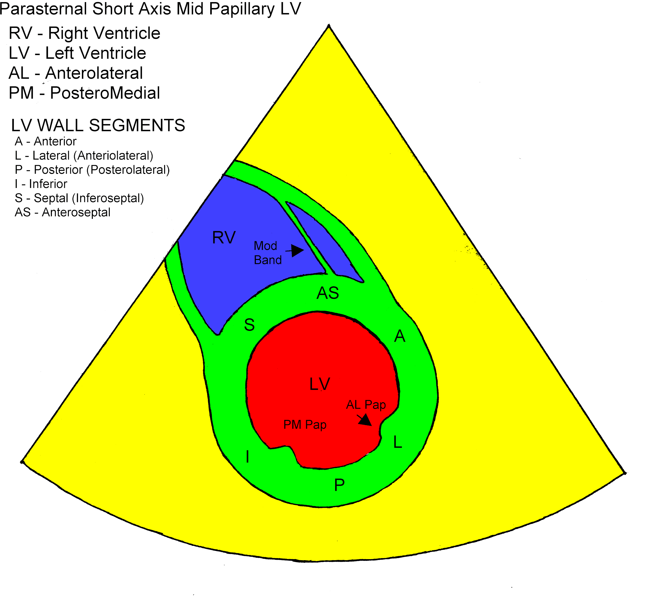
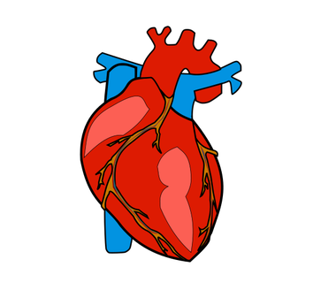
Overview
Medical image segmentation is an important feature of modern medicine.
Segmentation of the left and right ventricles of the heart are crucial for the timely diagnosis and treatment of cardiovascular disease.

Slide 2
Review of existing work
In the paper Deep Learning for Cardiac Image Segmentation: A Review by Chen et al., they state that FCNs and UNets are the default architecture for medical segmentation.
They also an approach of using GAN architecture for segmentation, replacing the generator network with a segmentation one.

Slide 3
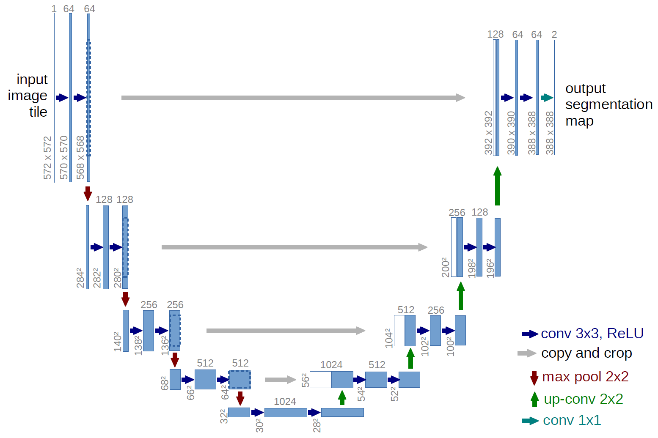
Approach
The first step of the process was creating a segmentation network similar to phase 1. This network is smaller, and outputs a 4 layer image.
The discriminator is simple CNN with 4 5x5 convolution layers, and 4 linear layers.

Slide 4
Approach
Training of GANs is a tricky process. There are many different possible loss functions to use, and the learning rate is difficult to select.
Through experimentation, I’ve found that the normal GAN loss function works best, as well as the ADAM optimizer with a learning rate of 0.00001.

Slide 5
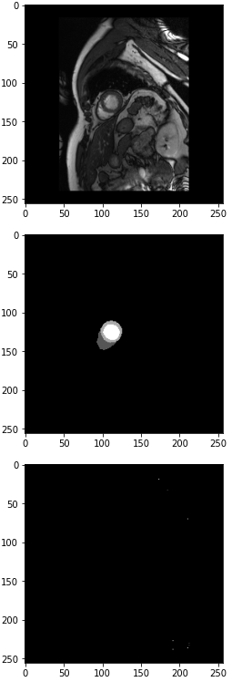
Results and Discussion
Training the networks if extremely difficult. The losses of each network never seemed to converge for long.
Trained an a low number of epochs, they seem start at the result of just background. This seems like a natural for an undertrained network to end up at, since this is also the result that worked best for an unweighted supervised network.

Slide 6
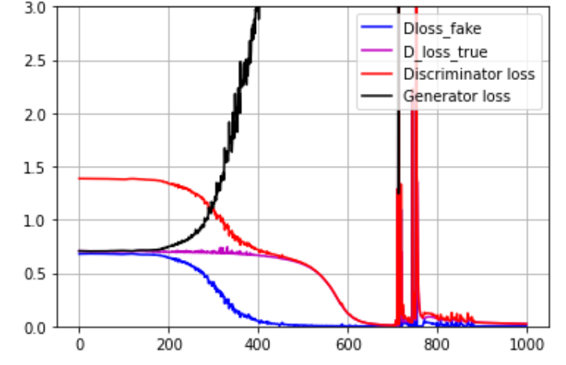
Results and Discussion: Weighted loss
With larger epochs, the losses experience large variations. No two training sessions are the same. The end results of the generator seems to be a image this is mostly classified as class 2, consistently across training.

Slide 7
Conclusion
This experiment turned out to be failure. The difficult nature of GANs makes both tuning and understanding where problems arise quite difficult.
For future I wish to revisit this problem from scratch. Do more research into GANs and spend more during tuning to arrive at the best solution.

